Slide 1
Introduction
Jessie Posilkin

Slide 2
Introduction to 18F
Jessie Posilkin

Slide 3
18F is a civic consultancy for the U.S. government, inside the U.S. government.
We just turned 3 and have 200 people.

Slide 4
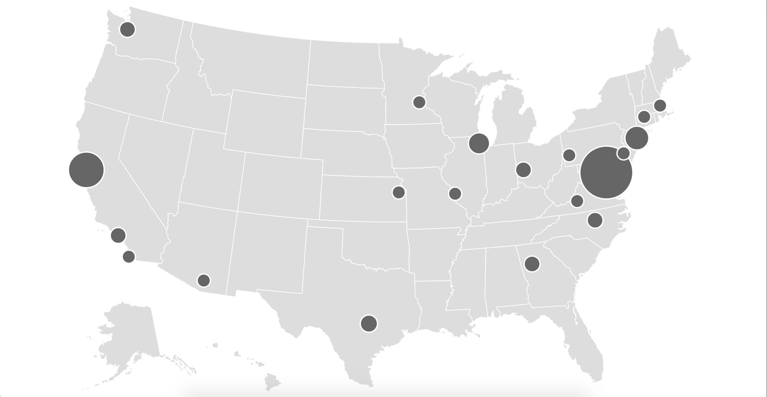
200 people
45% DC 55% everywhere else
Notes:
We have about 200 people, with just over half of the team living and working in a place that’s not Washington D.C. We span four U.S. timezones. We have offices in San Francisco, New York, Chicago, and D.C., and everyone else works from wherever they live. We’ve worked hard to provide the infrastructure and support for our team to live and work anywhere in the U.S.

Slide 5
Helping government buy better technology and make more effective procurement decisions.

Slide 6
Acquisition Services
Procurement
Agile BPA
Micropurchasing
CO collaboration
Consulting
Discovery sprints
RFP ghostwriting
Product management
Notes:
18F has a few strategies when it comes to our procurement work.

Slide 7
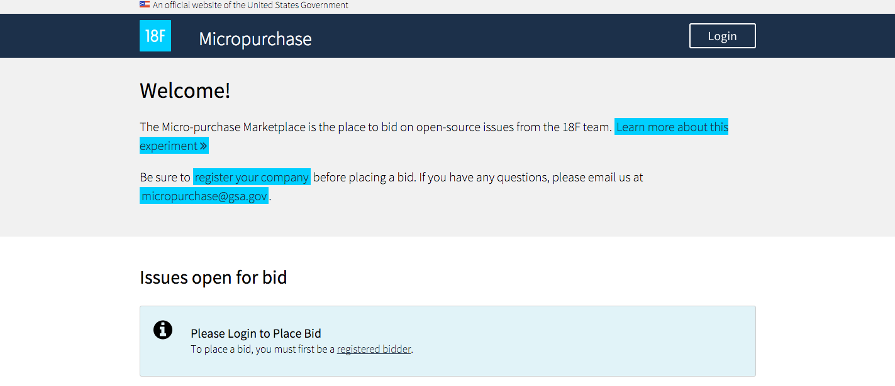

Slide 8
Brainstorm

Slide 9
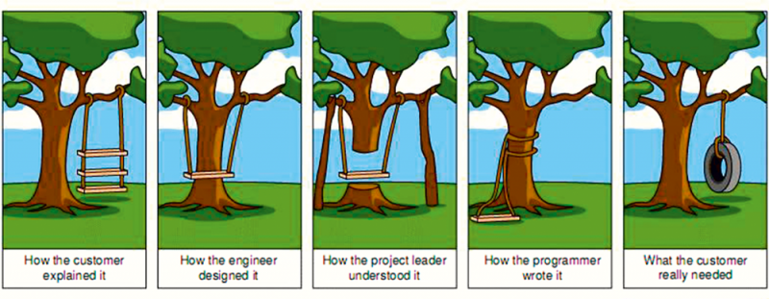
Communication is hard

Slide 10
What is Agile?
Individuals and interactions over processes and tools
Working software over comprehensive documentation
Customer collaboration over contract negotiation
Responding to change over following a plan
That is, while there is value in the items on the right,
we value the items on the left more.

Slide 11
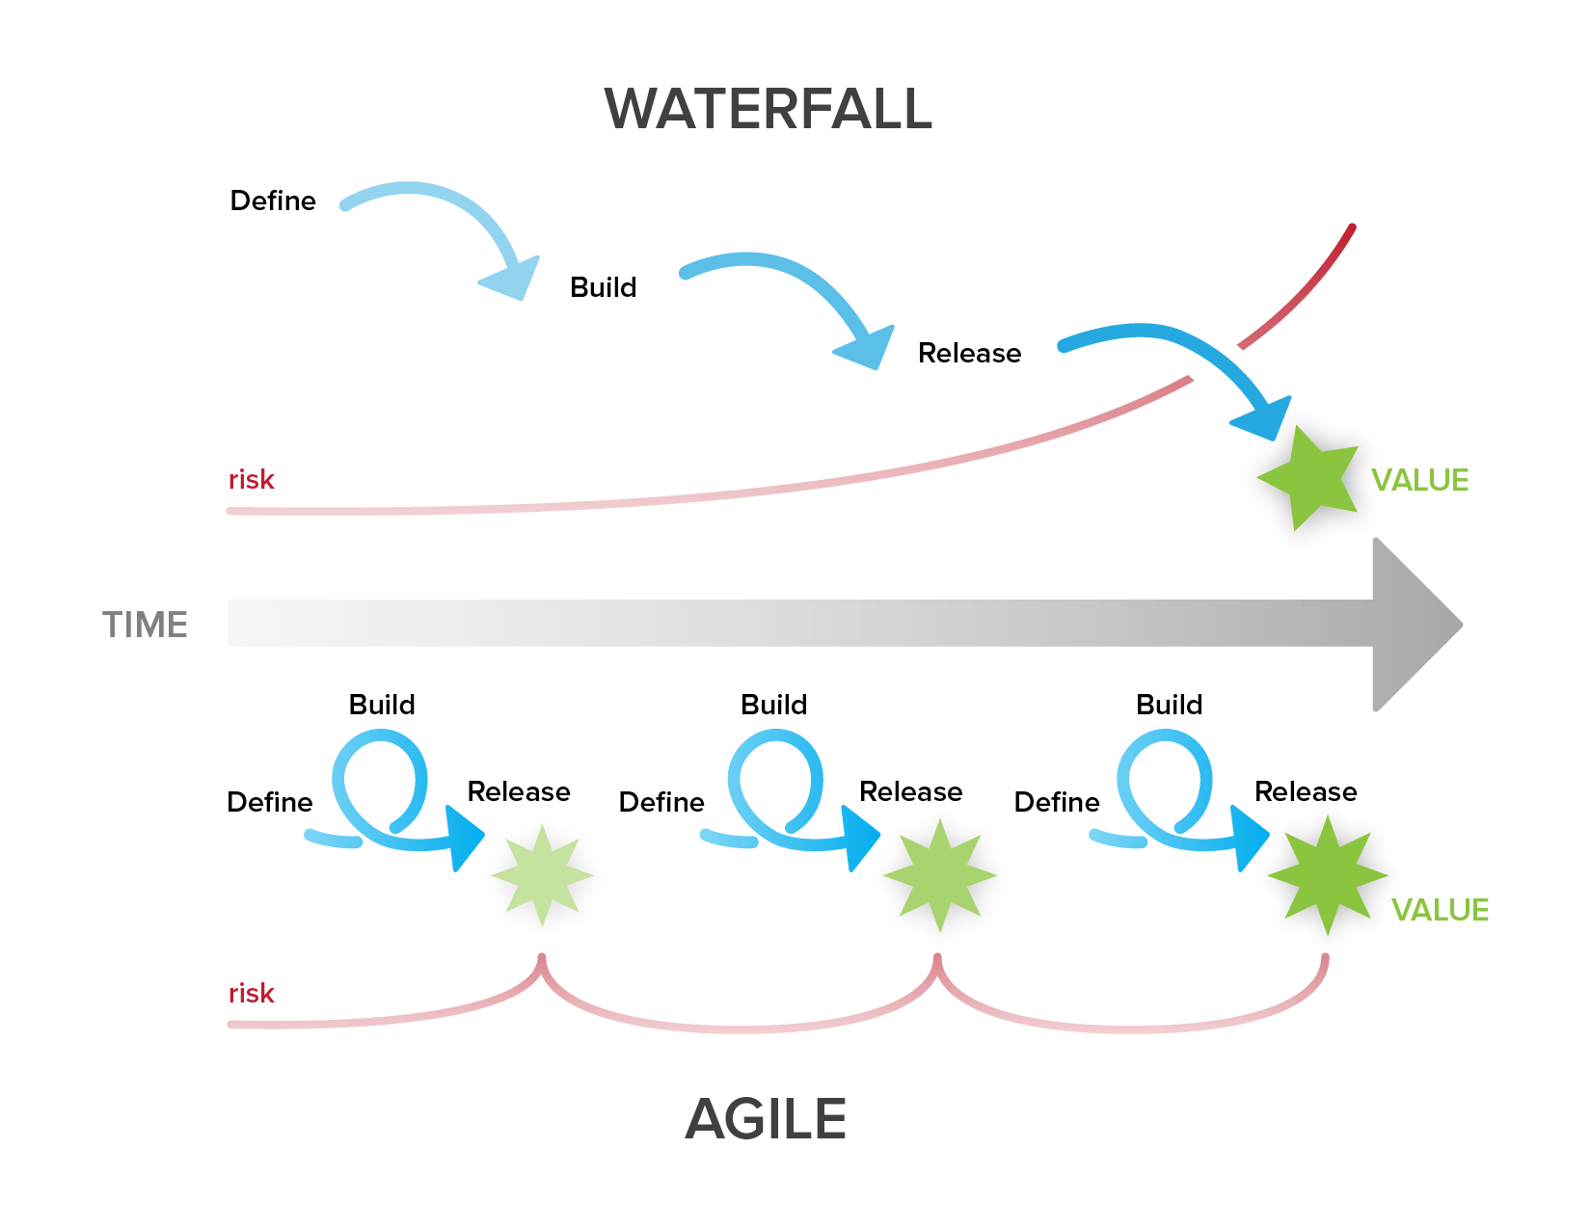
Notes:
in essence, we advocate for a continuous cycle
service or product is never done
yet we chunk up complexity small enough to have a lot of little dones

Slide 12
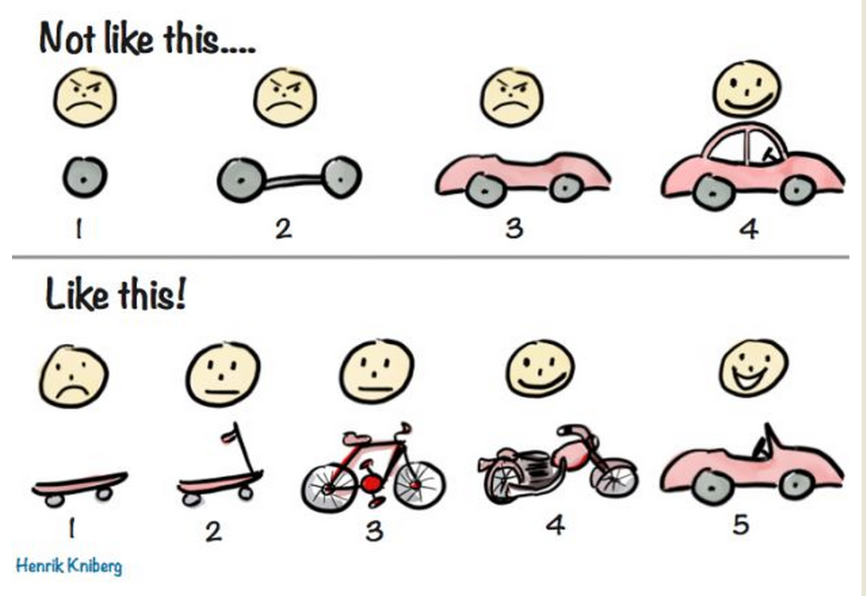

Slide 13
Agile in Action
Don’t look for the perfect solution
Be willing to experiment
Take time to learn and to get things wrong
Notes:
Stories from experimentation (depending on which buys have gone public)

Slide 14
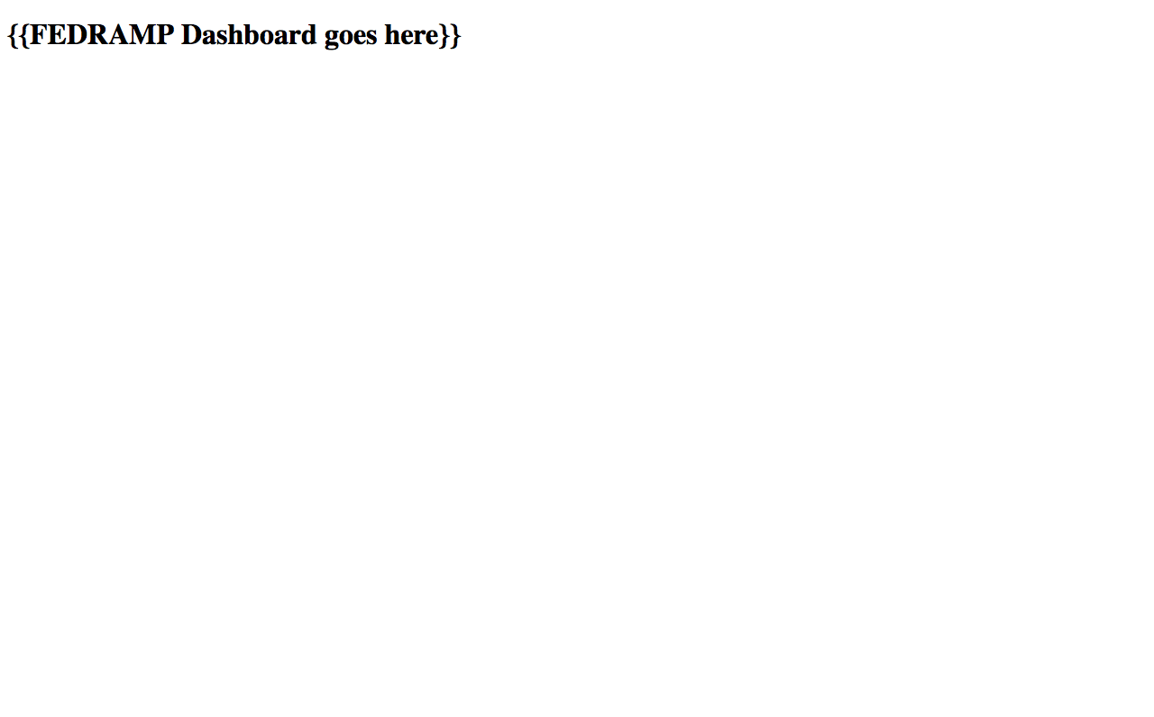
Prototyping

